Slide 1
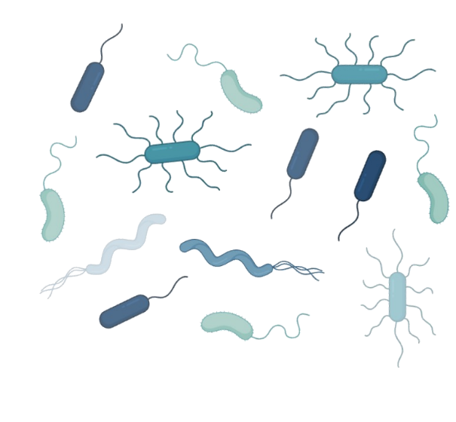
Longitudinal profiling of the burn patient cutaneous and gastrointestinal microbiota
Ziyu Xue

Slide 2
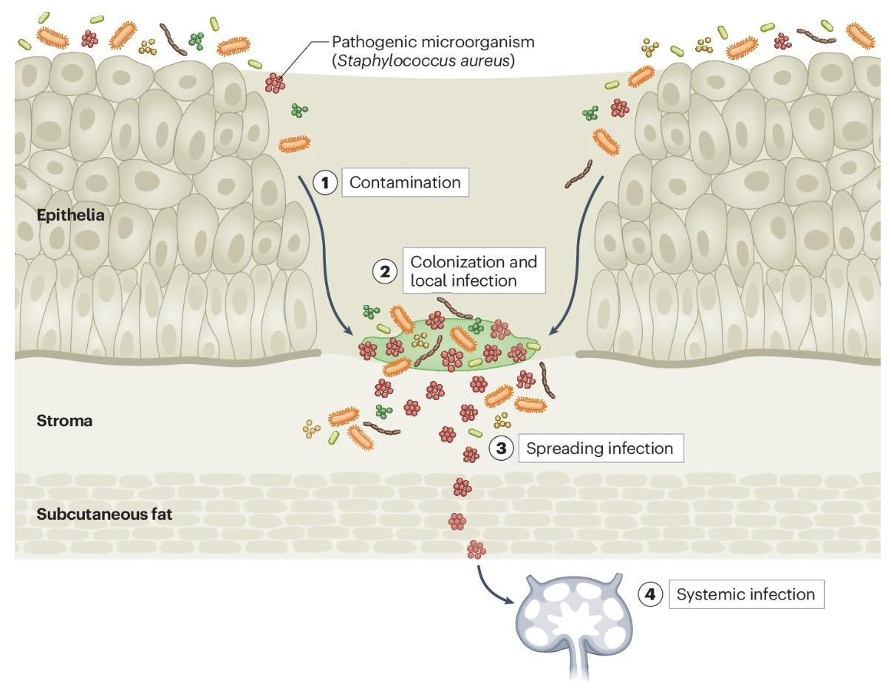
Burn wound microbiome is key to healing outcome
Colonization of wound by commensal/pathogenic bacteria
Activated immune response target all bacteria alike
Different communities play different role in wound healing
Notes:
although less talked about than the gut microbiome
the skin microbiome is a very important layer in shielding us from harmful bacteria in the environment and helping maintain the health of our skin
it’s intuitive to think that when the skin gets damaged, the skin microbime would also be distrupted
in the case of burn wounds,
the burn probably wipes out some microbes initially,
the activated immune response will also target all the bacteria in the region
but at the same time, the wounded area will be quickly colonized by either your commensal skin bacteria, or pathogenic bacteria
these different bacterial communities play different roles in wound healing process
some helps restore the homeostasis, some causes bad infection
hence there is the general consensus that the microbial composition of skin wound impacts wound healing
but past studies have produced conflicting results on how exactly this occurs
so this study aimed to produce some preliminary data on longitudinal sampling of skin microbiome in severely burned patients and to provide some understanding of microbial population dynamics over the course of treatment
additionally, burn wounds is not just a skin issue
it causes systematic responses in the body
for example sepsis
or for example the antibiotics patients take will impact the gut microbiome
so the authors also collected data on the temporal changes in the patient’s gut microbiome

Slide 3
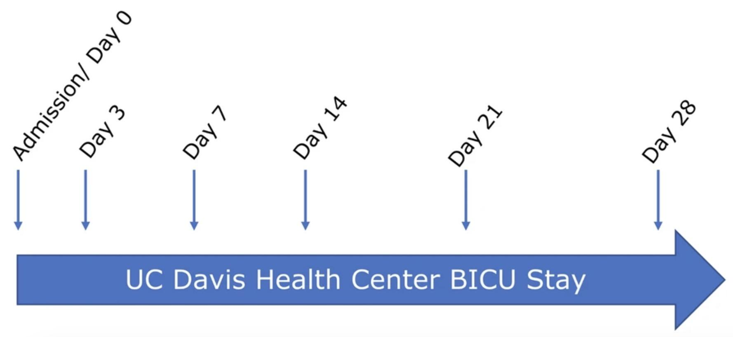
Longitudinal profiling of burn patient microbiota
Tissue collected:
Burn wound
Corresponding spared skin
Rectal
Perianal
Notes:
here’s a simple outline of what they did
they collected samples from severly burned patients after admission to the hospital on six different days
and each day, they collected samples from 4 different sites
burn wound on one of their forearm
spared skin on the corresponding area on their other forearm
and GI samples including rectal and perianal

Slide 4
Question
How do microbial communities at burn wounds vs. spared skin differ?
How do these bacterial populations change over time?
How are gut microbial communities altered?
Notes:
and the general questions i asked during my analysis are
How do microbial communities at burn wounds vs. spared skin differ?
How do these bacterial populations change over time?
How are gut microbial communities altered?

Slide 5
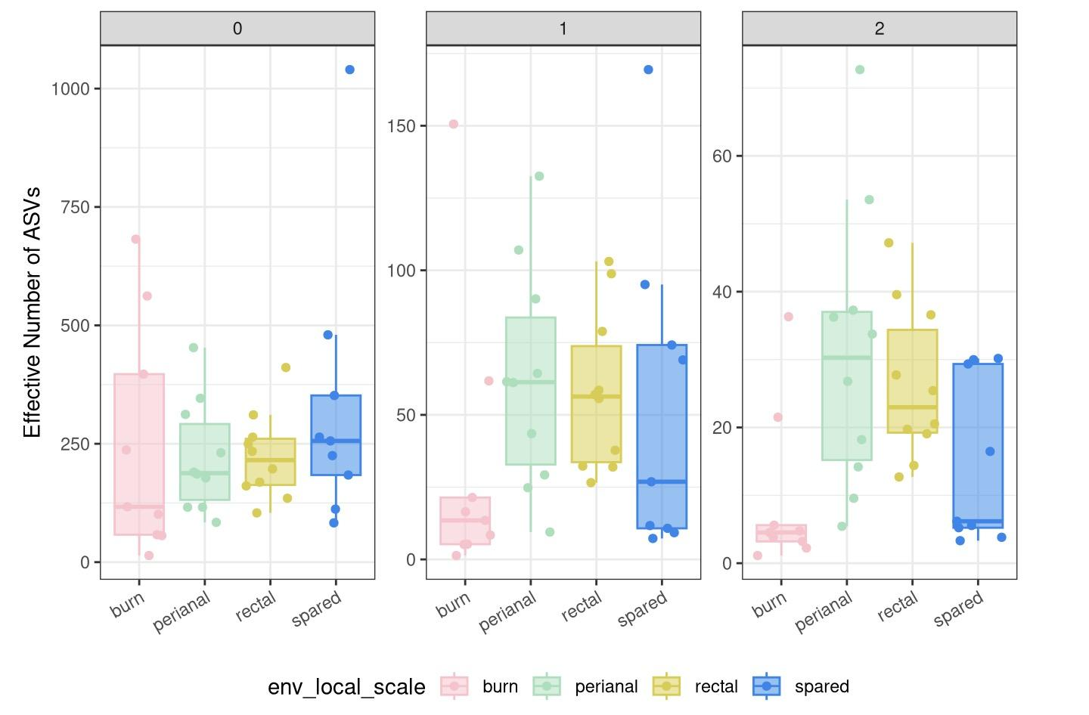
Difference in alpha diversity reflected more using abundance-unweighted measures
Notes:
I first looked at the alpha diversity of samples on day 0, which reflects more of the result from the burn before treatment
oh i just realized that i grouped these weirdly
but first of all, GI samples have very different abandances of their dominant species compared t the skin samples, whcih is expected
and looking at the burn vs spared, burn wounds have lower alpha diversity, and this is mroe reflected in richness measure
which means that the difference is driven by rare taxa and spared skin have more species
and this makes sense because one can imagine perhaps the burn wiped out some species

Slide 6
Does alpha diversity change over days post admission?
Null hypothesis:
Microbial diversity does not change over the days post admission
Alternative hypothesis:
For burn wounds: Microbial diversity will be regained/ increase over the days.
For spared skin: Microbial diversity will decrease over the days.
Notes:
and then im interested in how alpha diversity changes over time for the skin samples
My hypothesis is that the burn wound will have increasing alpha diversity since it will regain microbes as it recovers
but the spared skin might decrease in alpha diversity because the patients are now in a more clean hospital setting, and taking antibiotics and stuff

Slide 7
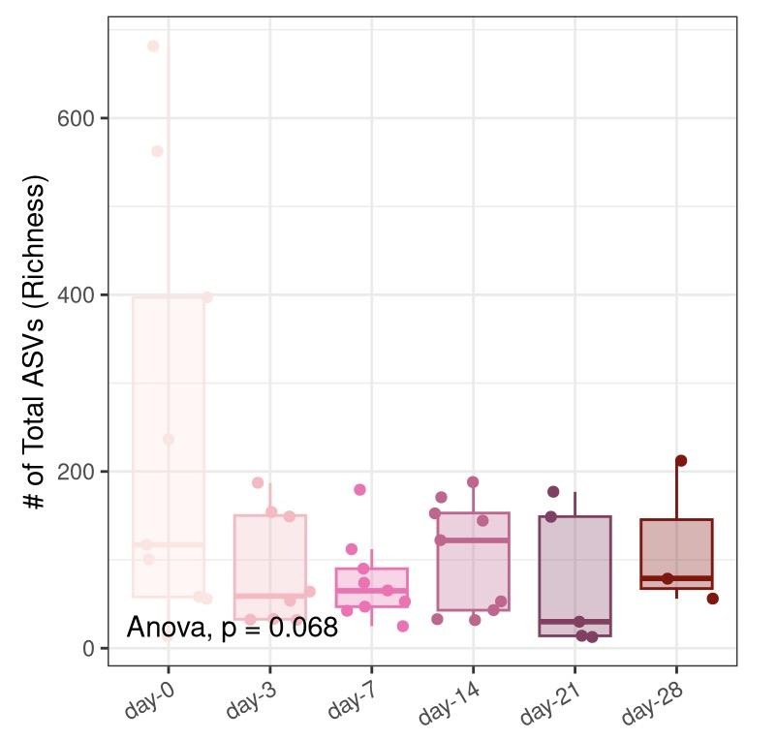
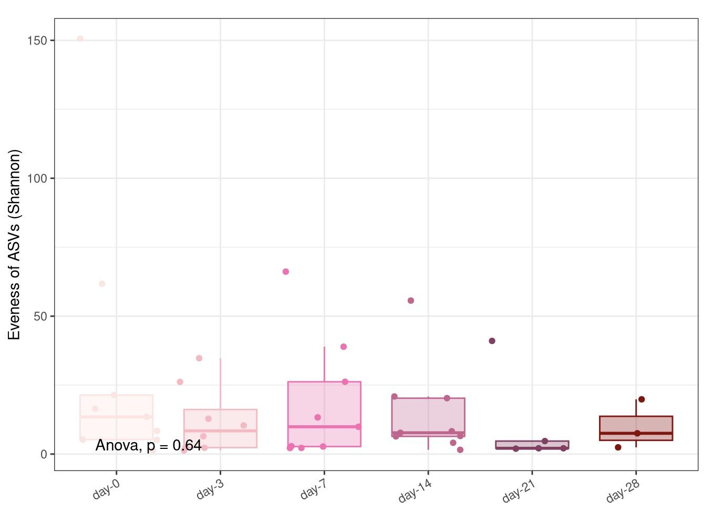
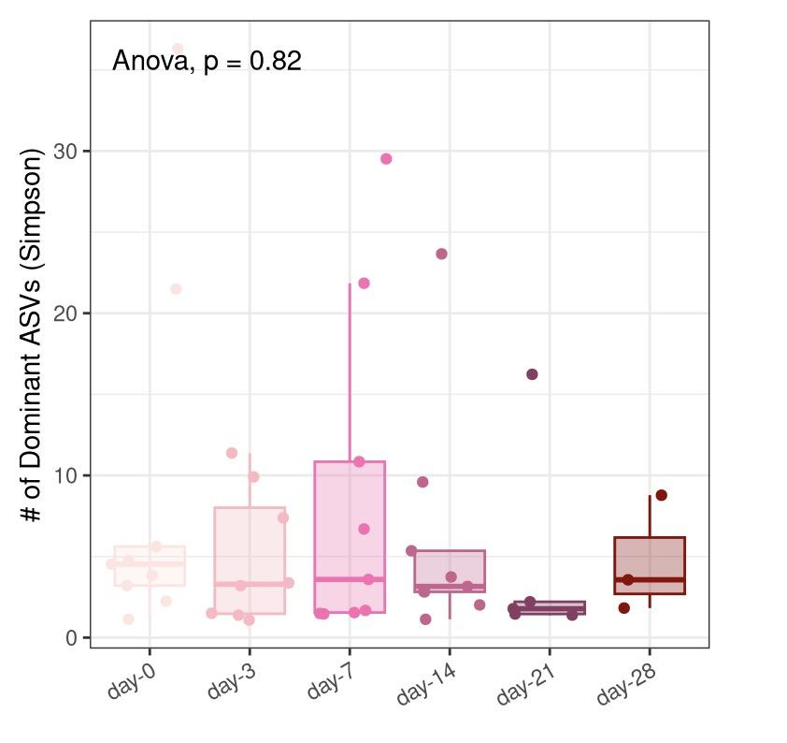
No change in alpha diversity over days for burn wounds
Richness Shannon Simpson
Notes:
however, there isn’t strong enough of a p value to reject the null hypothesis in either case,
no matter what diversity metric im looking at
There is not a clear change in alphs diversity for burn or spared skin samples

Slide 8
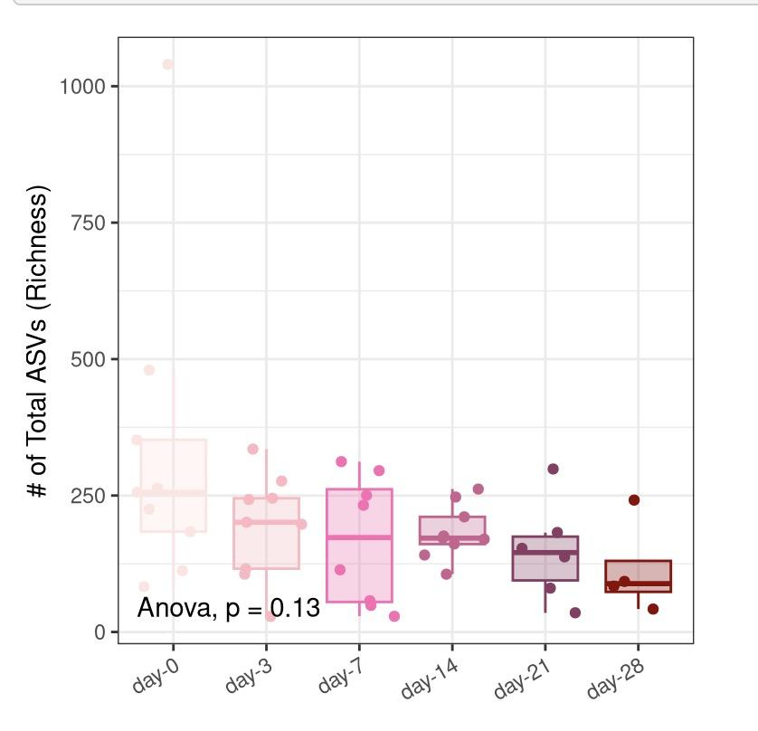
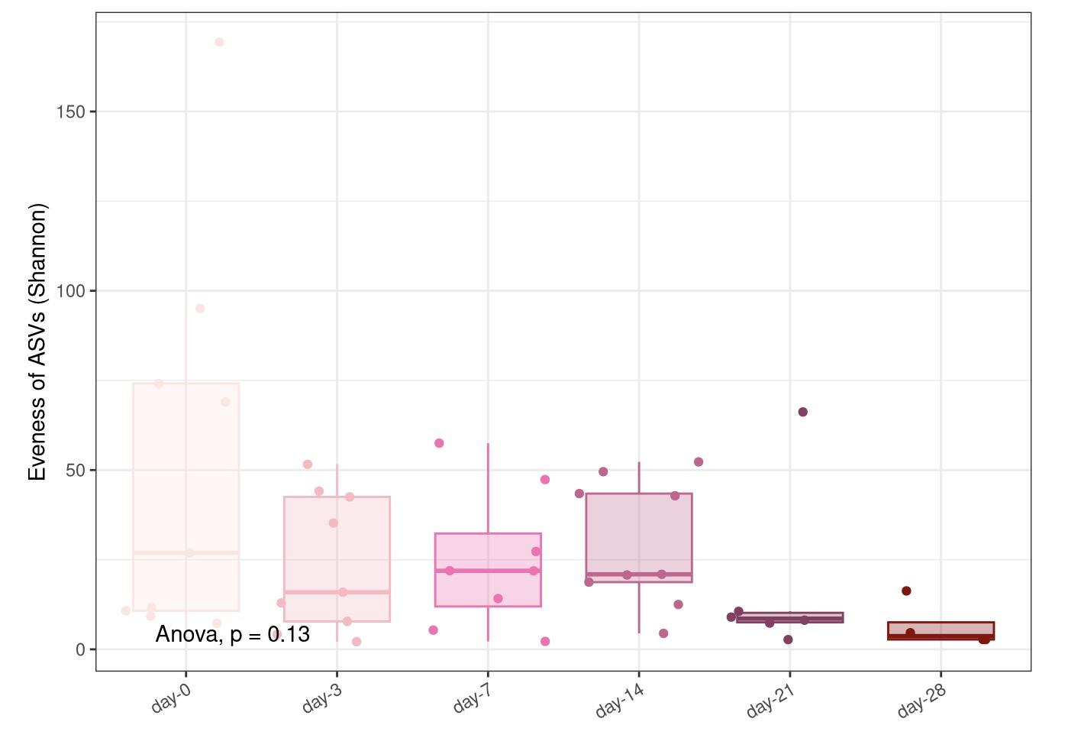
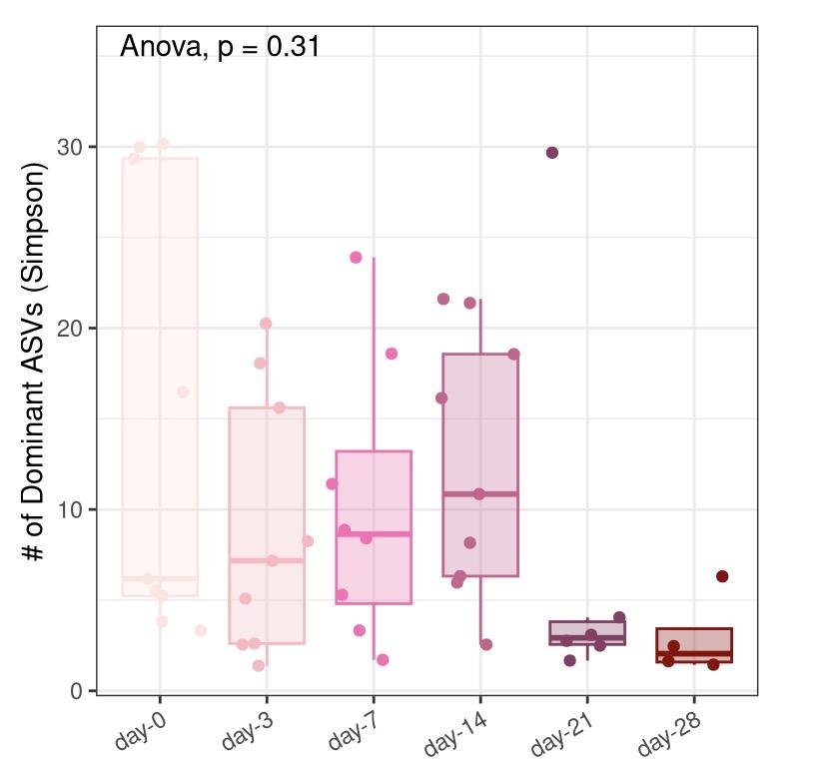
No change in alpha diversity over days for spared skin
Richness Shannon Simpson

Slide 9
Does microbial composition differ across days post-admission?
Null hypothesis:
There is no significant difference in the microbial community composition (based on Bray-Curtis distances) across the collection days post-admission.
Alternative hypothesis:
For burn wounds: The relative abundance profiles of bacterial communities in burn wounds significantly differ across the collection days post-admission.
Notes:
so the alpha diversity didnt change,
but what about beta diversity, does the composition of microbial communities change over the days
since the burn wounds are not in homeostasis and are in an active recovery process, I hypothesized that the elative abundance profiles of bacterial communities in burn wounds significantly differ across the collection days post-admission

Slide 10
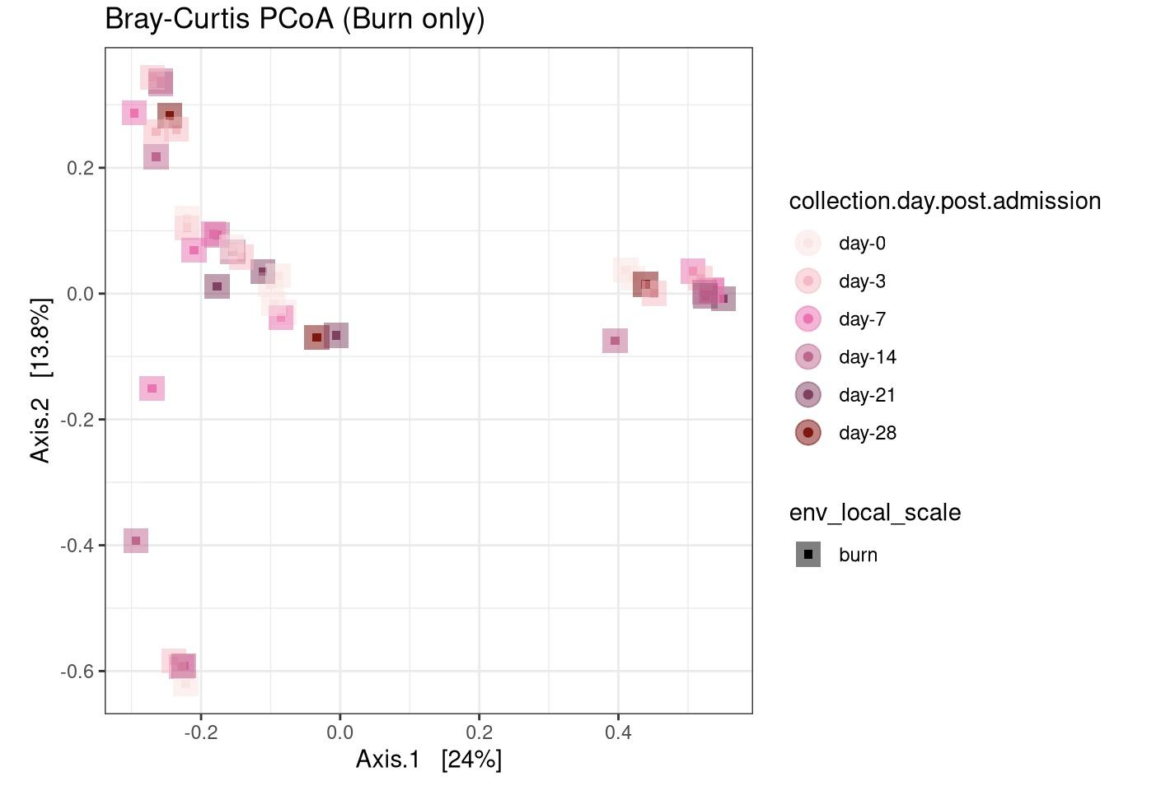
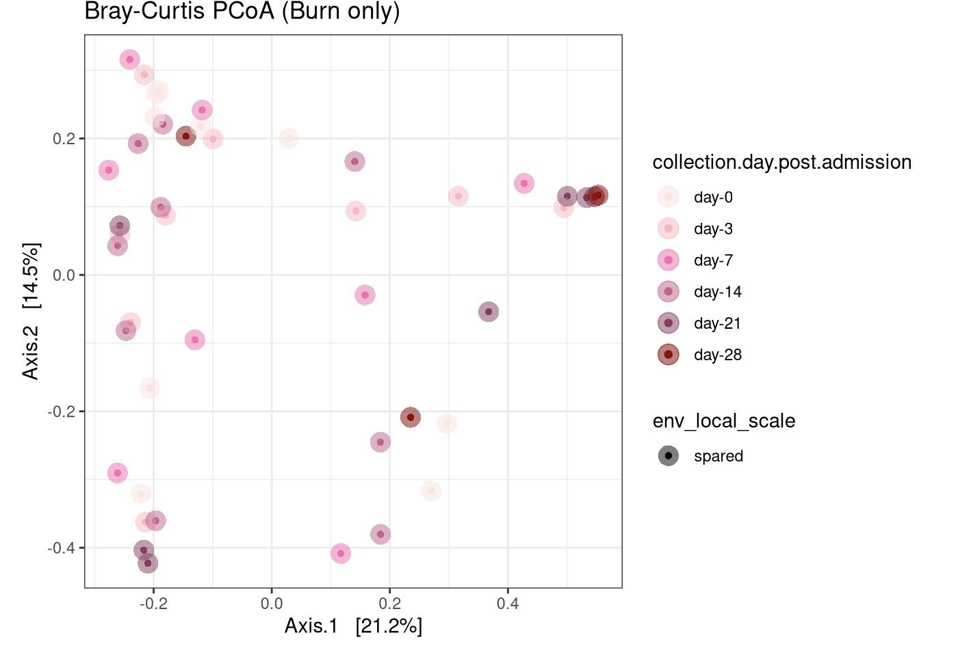
Bray-Curtis PCoA:
No clustering seen based on collection date
R² = 0.11513
F = 0.9628
p = 0.553
R² = 0.116
F = 0.116
p = 0.43
Notes:
here are what the bray-curtis PcoA plots look like for burn samples and spared samples
, there is no clear clustering based on dates
and as you can tell from the statistics, the group centriods are not significantly different

Slide 11
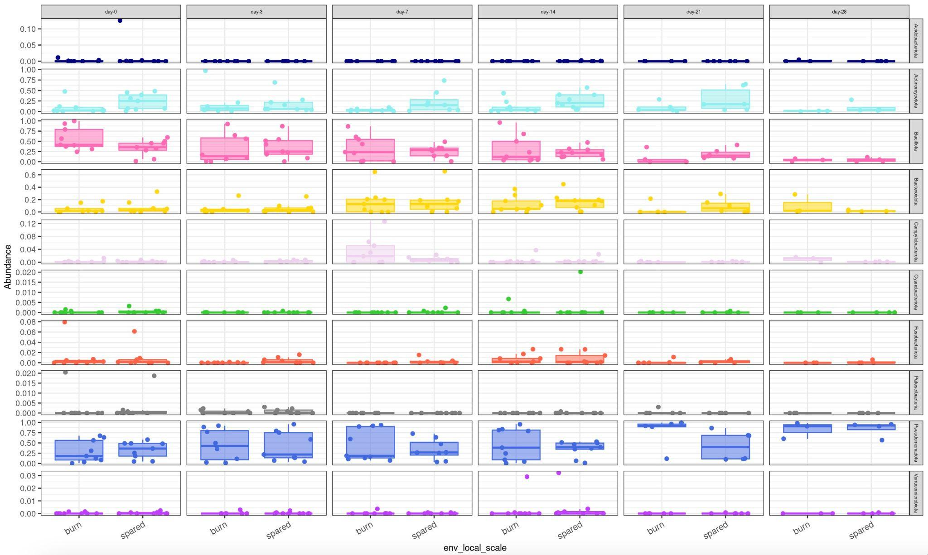
Investigating microbial composition:
Bacillota (Firmicutes) phylum shows interesting trends
Notes:
looking into whether are any potential microbes driving any change in structure
I plotted the abundances of the top 10 phyla in skin samples over the days and on burn vs spared skin samples
and I decided to focus on bacillota or firmicutes because

Slide 12
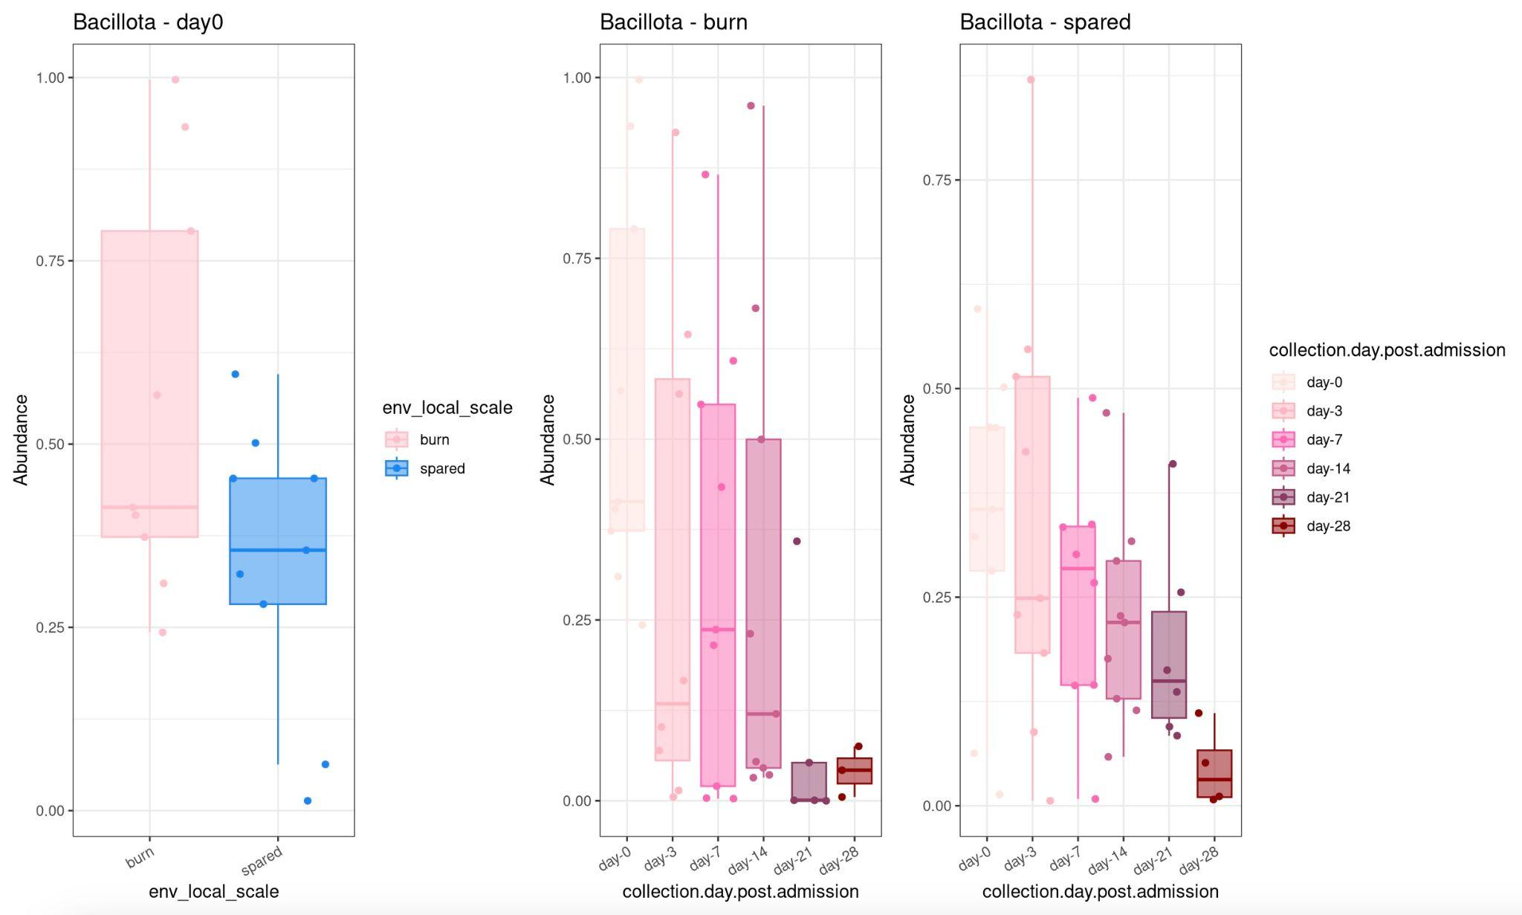
Focusing on Firmicutes:
Abundances decrease over days post-admission
Notes:
if i zoom in on it more, you can see that not only does there seem to be a difference between burn vs spared samples, but there also seems to be a decreasing trend in abundance

Slide 13
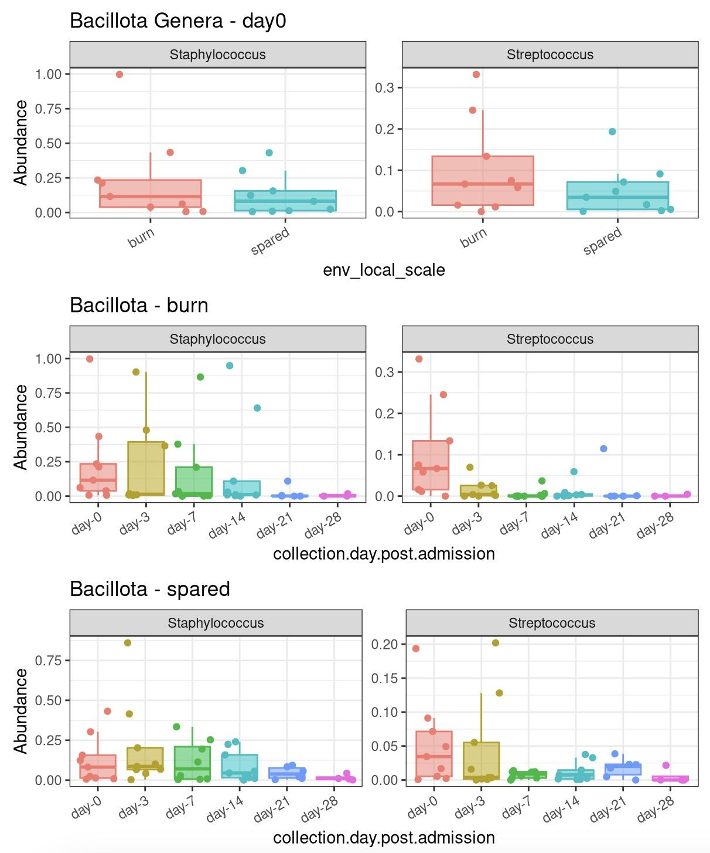
Trends may be driven by Staph and Strep genera
Notes:
dissecting it more, I found that the genera that shows similar strend as the phylum are staphyococcos and streptococcus
their abudances start out higher in burn wounds and decreases over time in both burn and spared skin

Slide 14
Trends may be driven by Staph and Strep genera

Slide 15
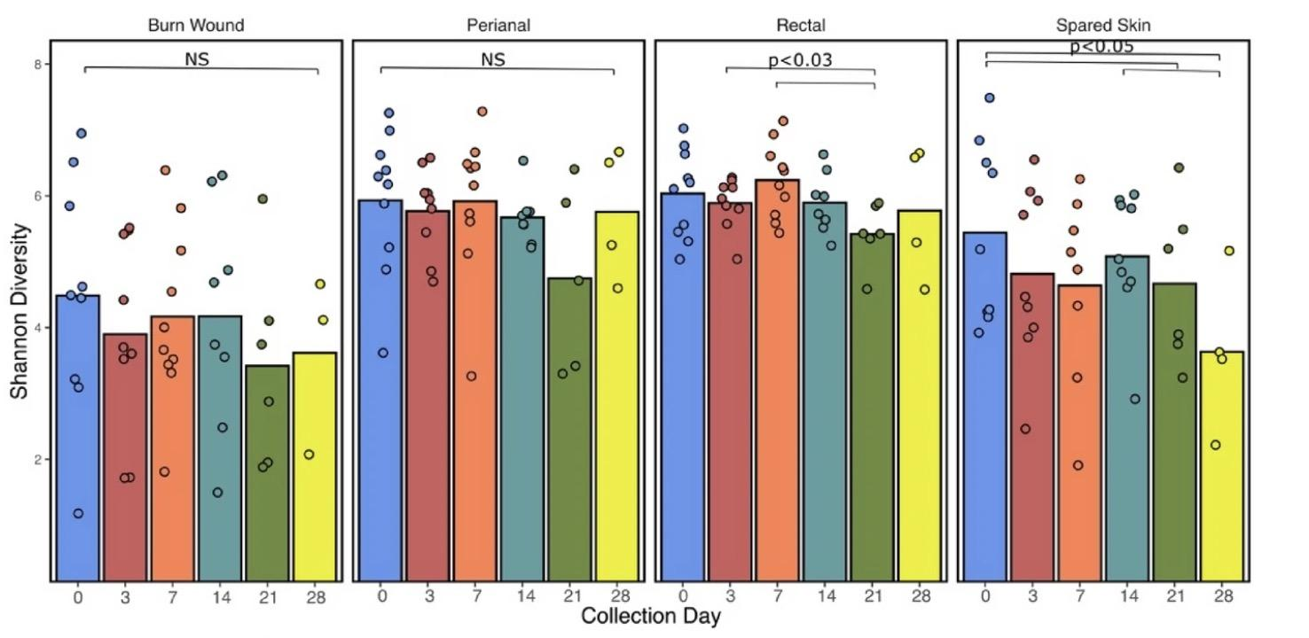
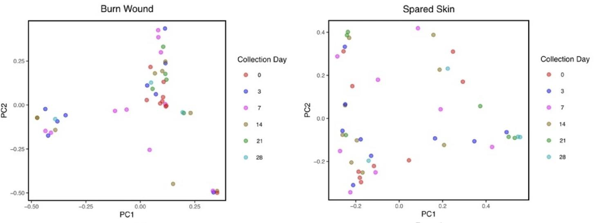
Similar results as findings in paper
No change in Shannon diversity over post-admission days
No clustering based on collection days
Potentially due to frequent antibiotic application
Temporal reduction/stability in wound microbiome indicative poor healing results
Notes:
summarizing what i found thrugh my analysis so far and comparing it to findings in the paper,
we both found no change in alpha diveristy over time and no clustering based on collection days
this is curious because it’s counterintuitive
and others studies usually suggest that temporal reduction or even stabiloty in wound microbiome are indicative of poor healing results
so perhaps the effects seen are temporary effects due to the application of antibiotics, and the we would need to track these severely burned patients for a longer period of time to see the recovery of their microbiome

Slide 16
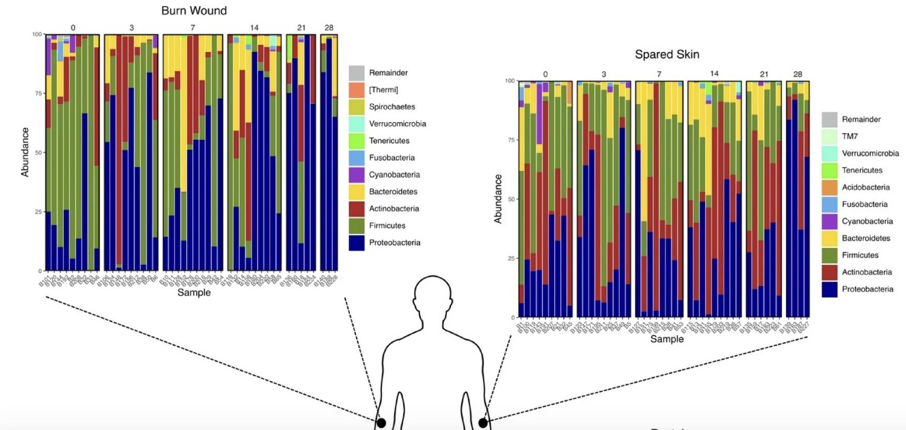
Similar results as findings in paper
Reduction in skin commensal organisms
Propionibacterium acnes and Staphylococcus epidermitis
Burn wounds experience perturbation of normal commensal bacteria
Notes:
thee paper also found the reduction in abundance in some specific organisms
on phylum level, you can see the decrease in firmicutes
this maybe just further goes to show that in burn wounds, the normal commensal bacteria are very disrupted

Slide 17
How are gut microbial communities altered?
Hypothesis:
Alpha diversity of gut microbiome decreases over days post-admission.
Relative abundance profiles of gut bacterial communities differ across days post-admission.
Notes:
circling back to the gut samples i mentioned in the beginning
i performed similar analysis on them and hypothesied that their alpha diversity will decrease over time and there will also be some change in composition

Slide 18
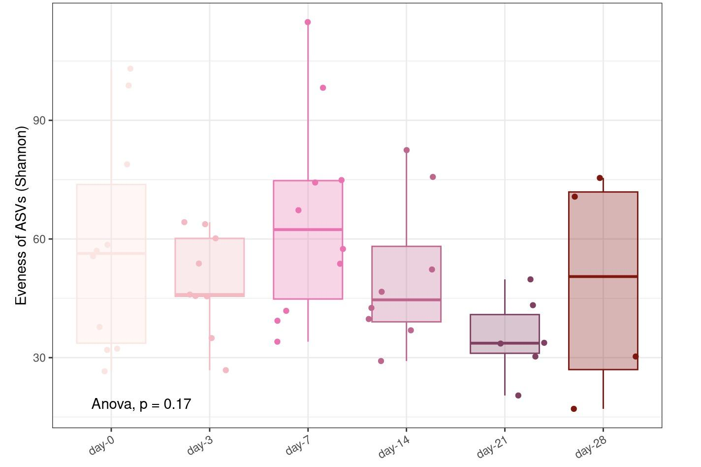
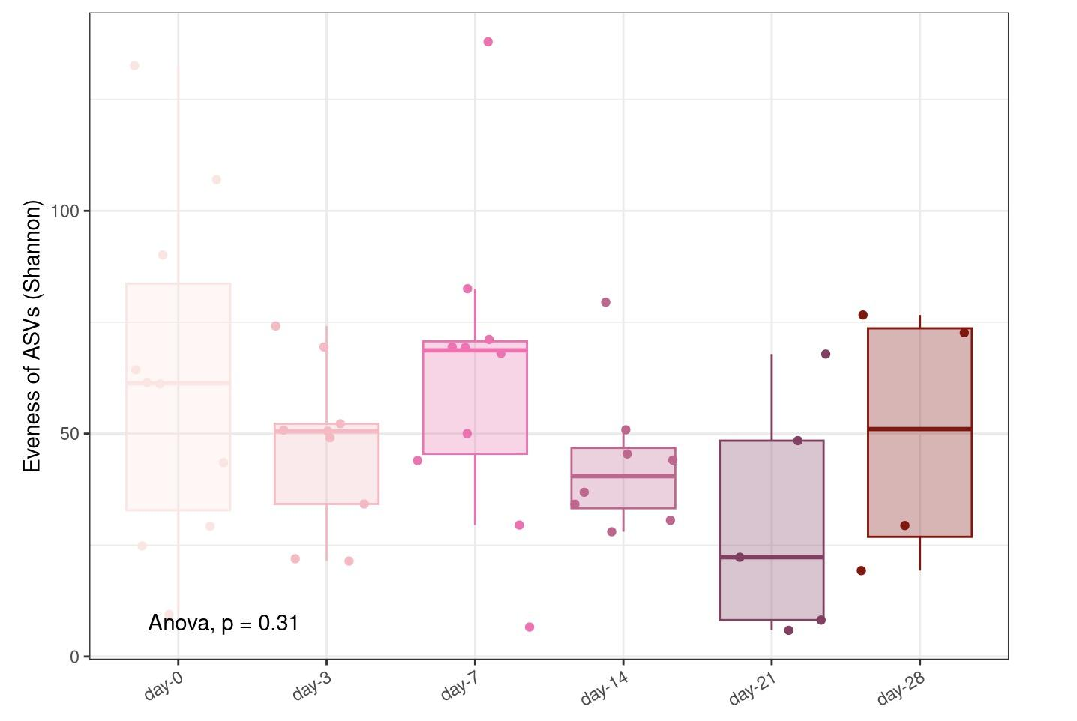
Drop in alpha diversity seen on day 21
Rectal Perianal
Notes:
but overall, the alpha diveristy stay pretty stable except for a dip on day 21
which is also seen in the results of the paper
as for beta diversity,

Slide 19
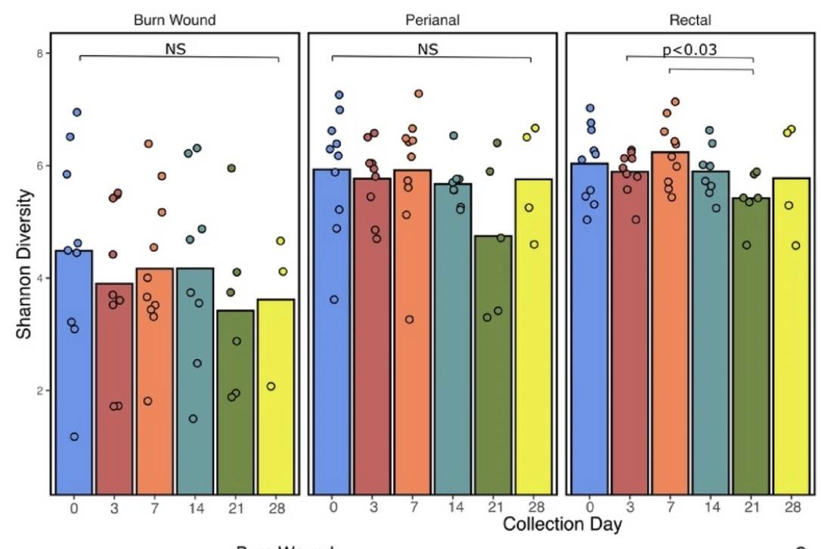
Drop in alpha diversity seen on day 21

Slide 20
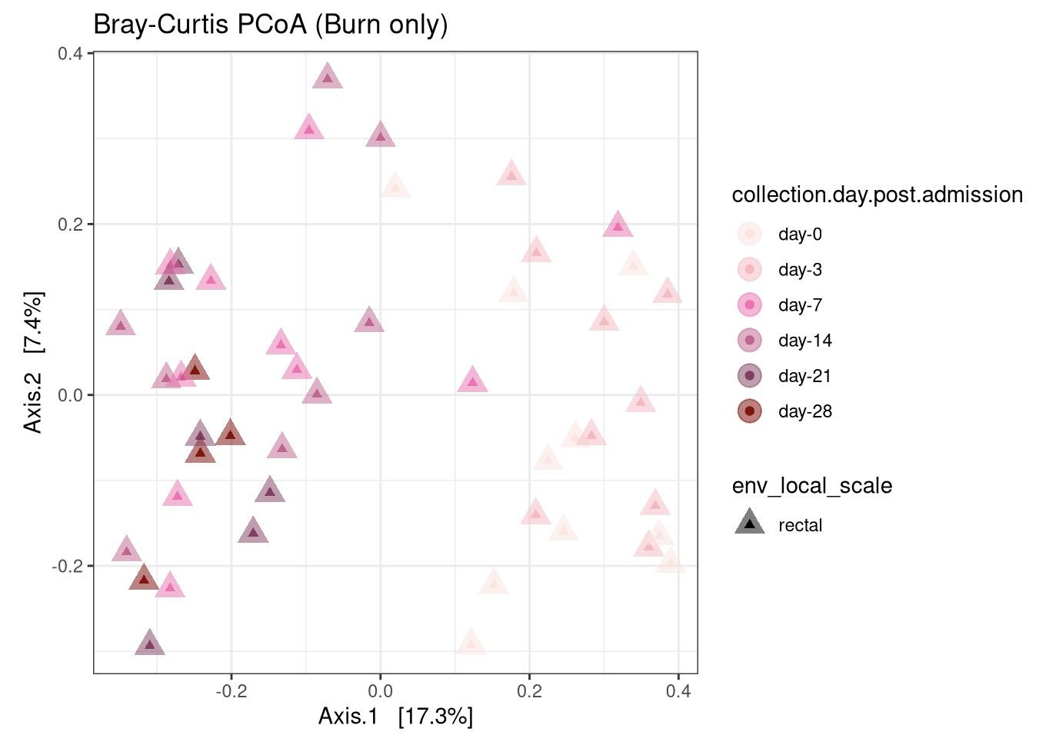
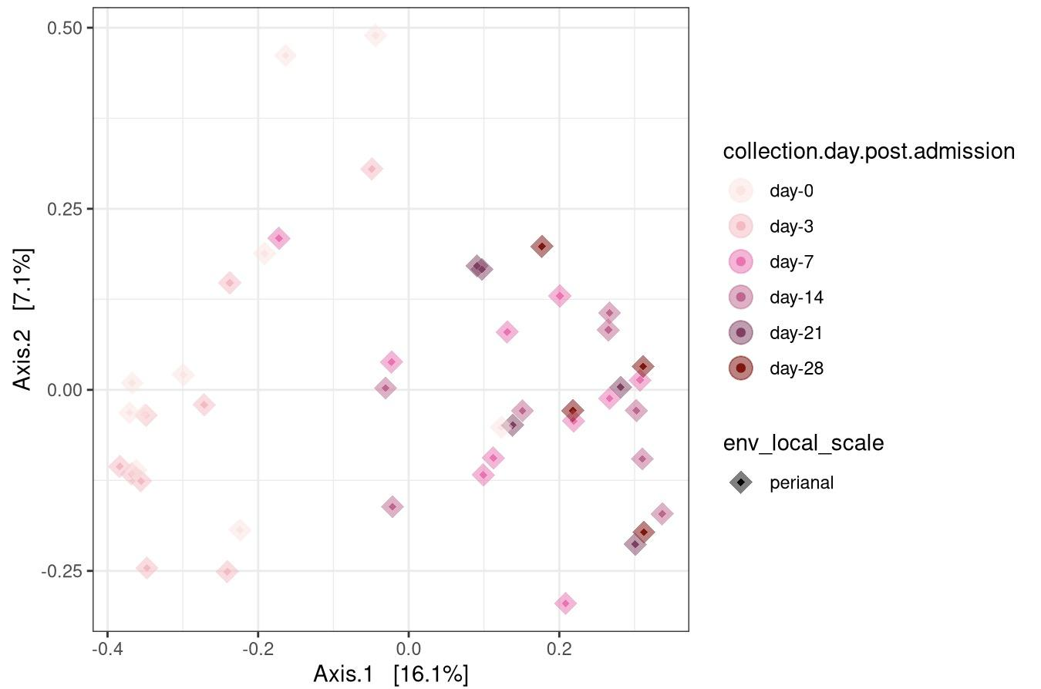
Clustering of samples based on dates
R² = 0.193
F = 1.97
p = 0.001
R² = 0.193
F = 1.91
p = 0.001
Notes:
the early day0 and day3 clustered together, while the later day samples clustered together
suggesting that a significant difference in their structure is seen and this is supported by a strong p value and also in agreement with the paper

Slide 21
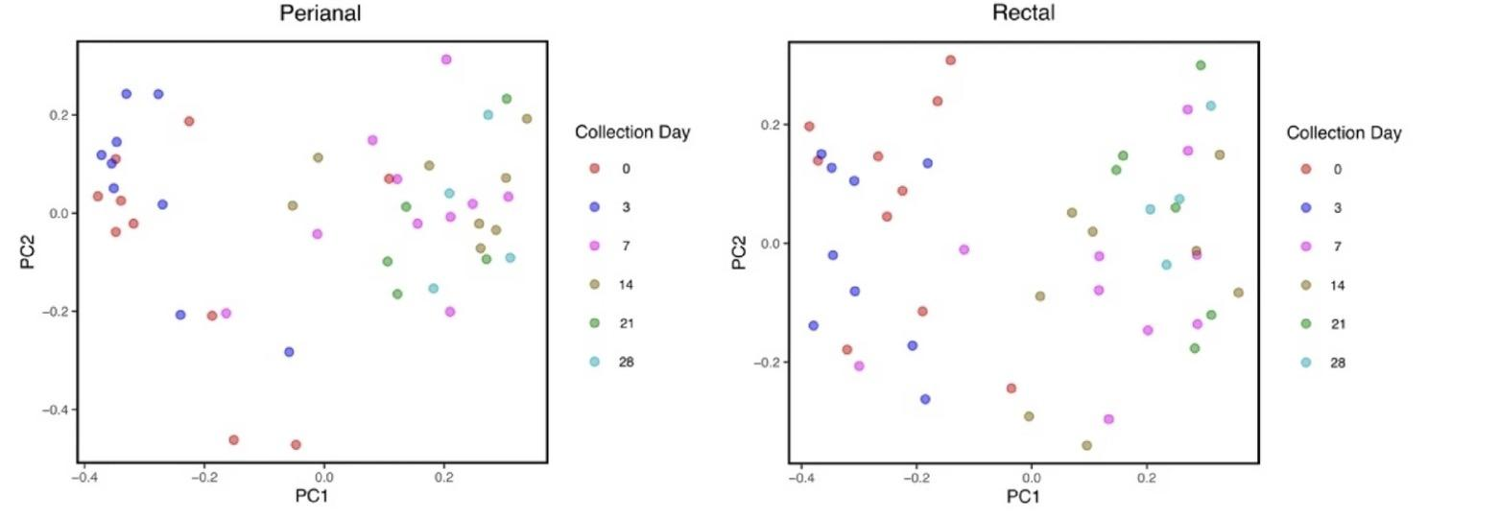
Clustering of samples based on dates

Slide 22
Conclusions
Burn wound microbial populations were significantly less diverse compared to spared skin.
No significant change in skin microbiome alpha diversity was observed over the days post-admission.
Abundance of Firmicutes in skin samples, specifically Staphylococcus and Streptococcus, decreased over time.
Rectal and perianal samples’ alpha diversity did not significantly change over time, but their beta diversity changes over time.

Slide 23
References
Lima, K. M., Davis, R. R., Liu, S. Y., Greenhalgh, D. G., & Tran, N. K. (2021). Longitudinal profiling of the burn patient cutaneous and gastrointestinal microbiota: a pilot study. Scientific reports, 11(1), 10667. https://doi.org/10.1038/s41598-021-89822-z
Uberoi, A., McCready-Vangi, A., & Grice, E. A. (2024). The wound microbiota: microbial mechanisms of impaired wound healing and infection. Nature reviews. Microbiology, 22(8), 507–521. https://doi.org/10.1038/s41579-024-01035-z
Corcione, S., Lupia, T., De Rosa, F. G., & Host and Microbiota Interaction Study Group (ESGHAMI) of the European Society of Clinical Microbiology and Infectious Diseases (ESCMID) (2020). Microbiome in the setting of burn patients: implications for infections and clinical outcomes. Burns & trauma, 8, tkaa033. https://doi.org/10.1093/burnst/tkaa033
Loesche, M., Gardner, S. E., Kalan, L., Horwinski, J., Zheng, Q., Hodkinson, B. P., Tyldsley, A. S., Franciscus, C. L., Hillis, S. L., Mehta, S., Margolis, D. J., & Grice, E. A. (2017). Temporal Stability in Chronic Wound Microbiota Is Associated With Poor Healing. The Journal of investigative dermatology, 137(1), 237–244. https://doi.org/10.1016/j.jid.2016.08.009

